Slide 2
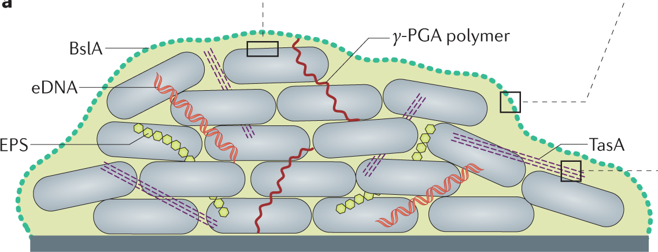
Project
Understanding the Regulation of
the Motile-Matrix Switch in Bacillus subtilis
Motivation & Aim
Modelling method & findings at single cell level
Modelling method at biofilm level
Pannaree Boonyuen
Part III Systems Biology
Diana Fusco, Nikhil Krishnan
Dept of Physics
Matrix

Slide 3
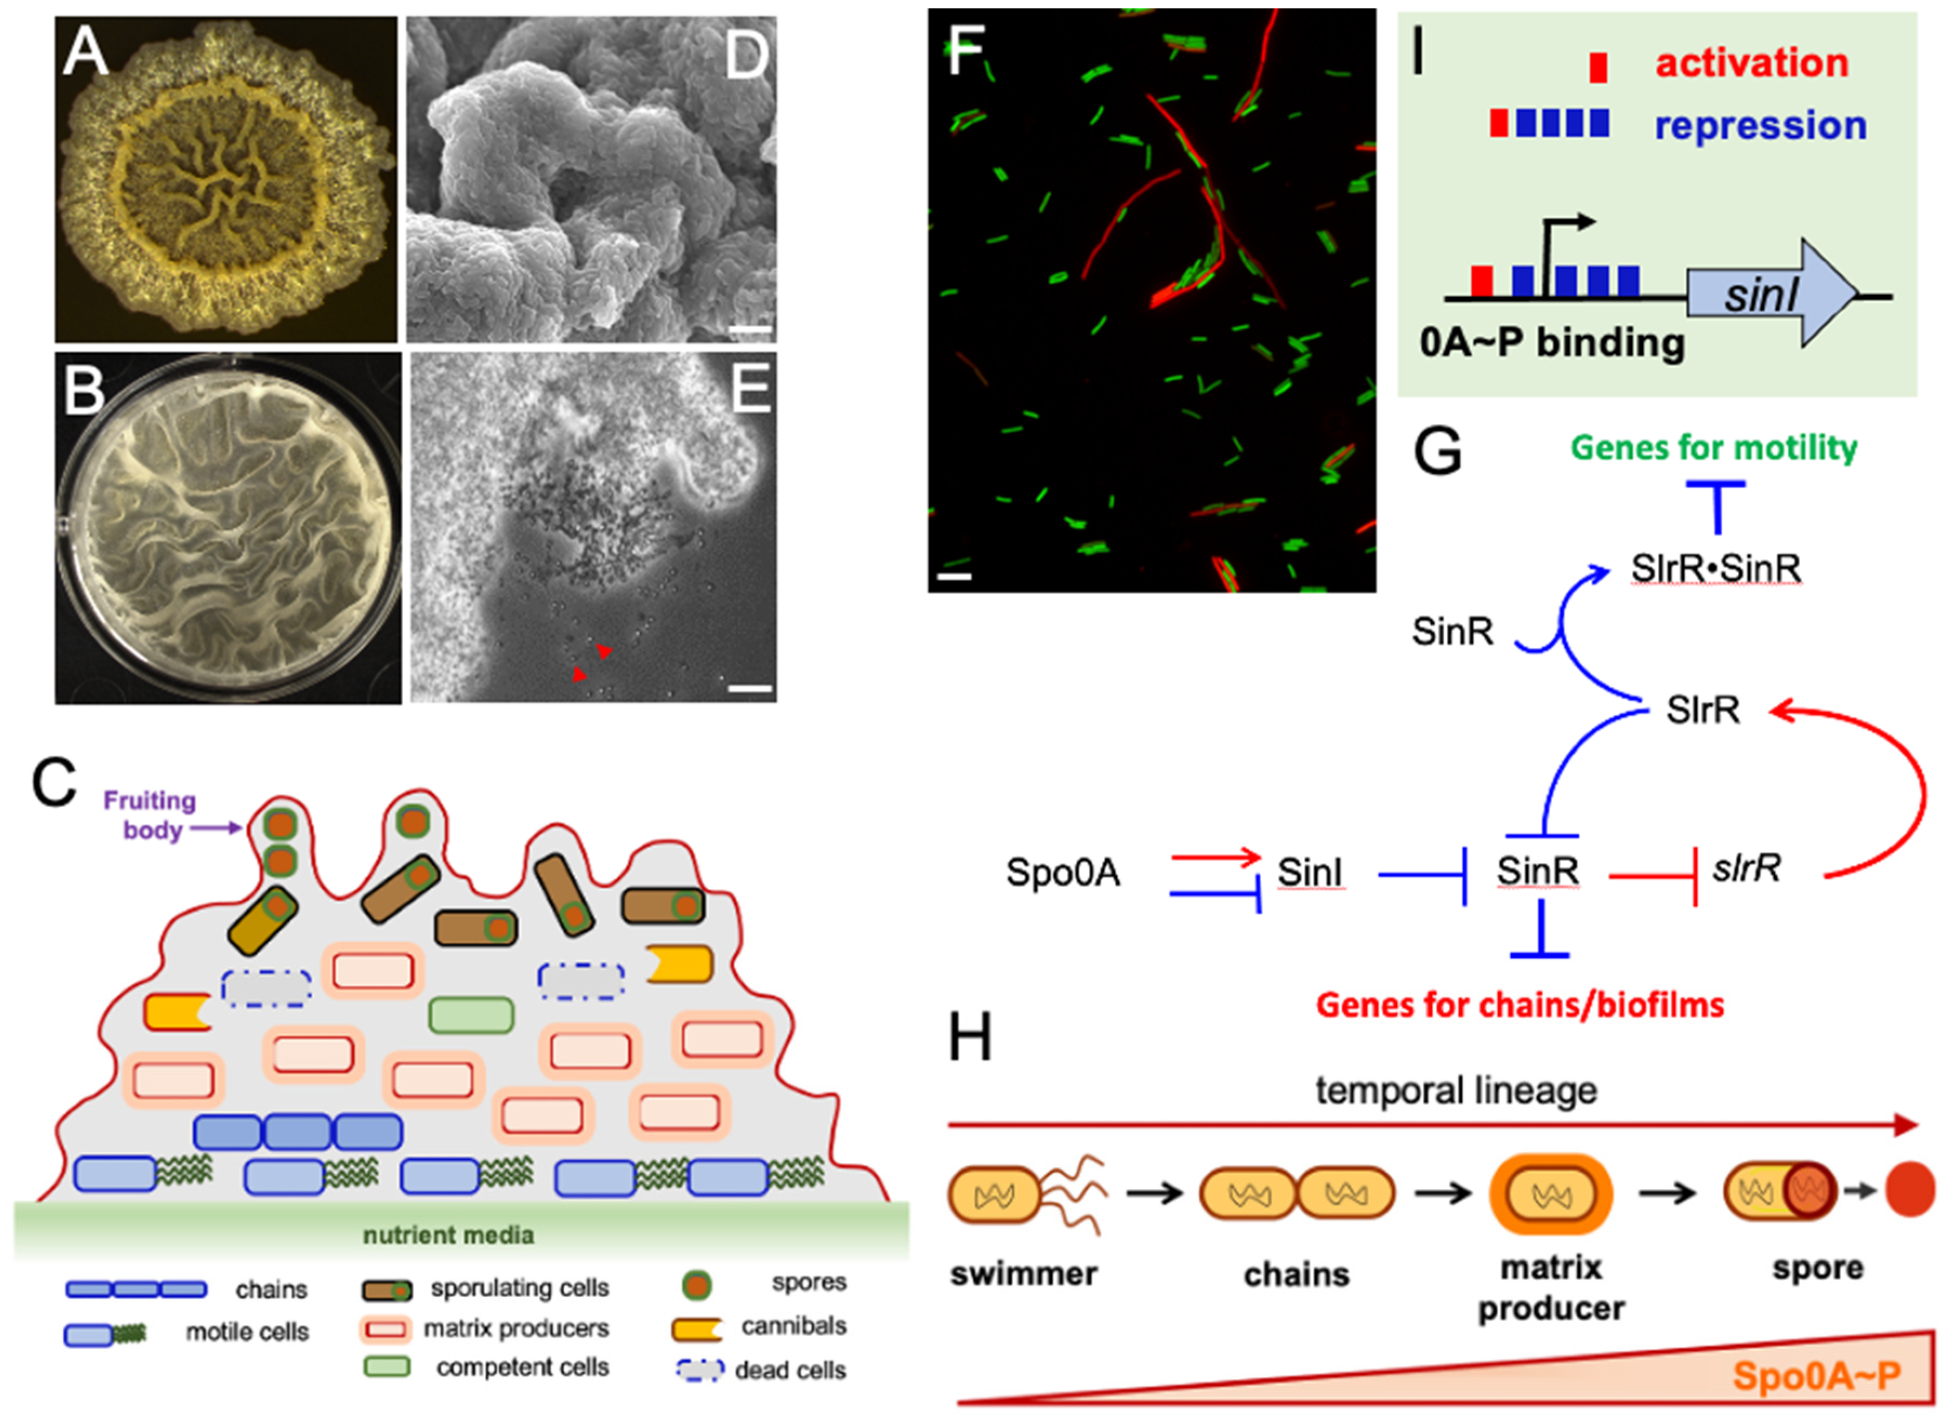
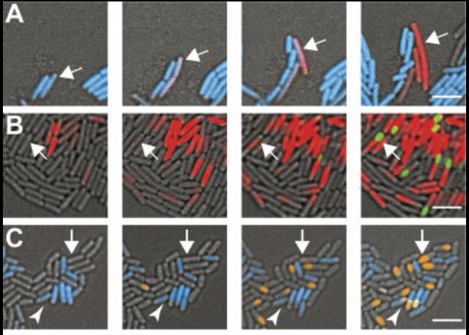
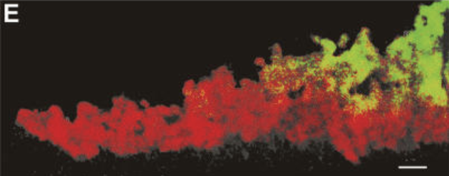
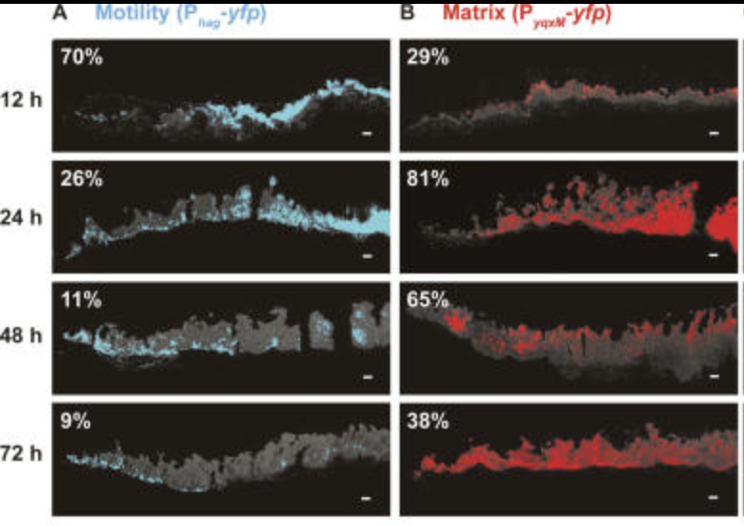
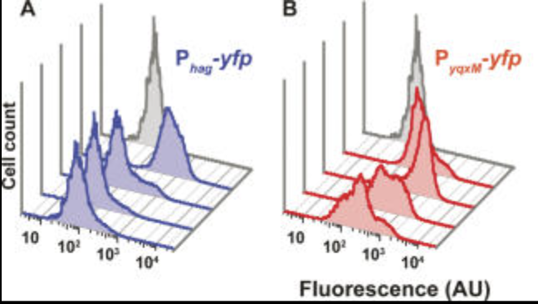
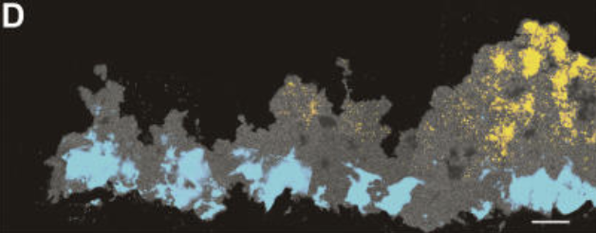
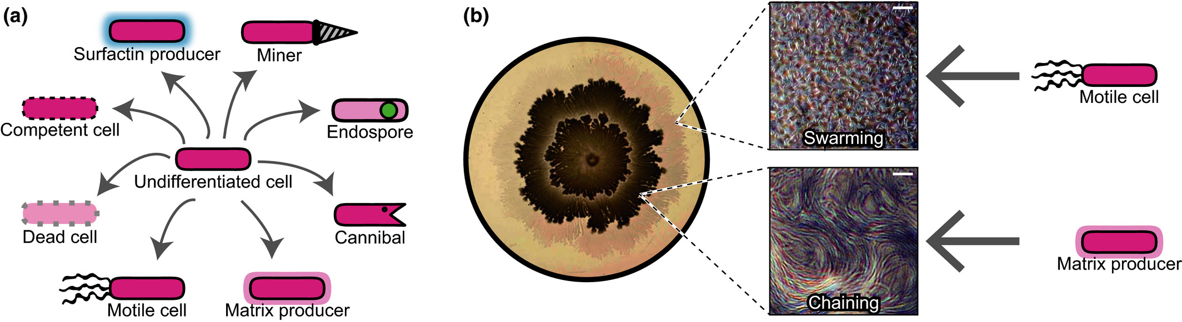
Biofilm Heterogeneity
Studying Bacillus subtilis Matrix-Motile Phase Switching Behaviours by Stochastic modelling
Motivation
Temporal heterogeneity
Single cell-level
Population-level
Spatial heterogeneity
Population-level depth-wise
Spatial heterogeneity
Blue – motile cell (Phag)
Red – matrix cell (PtapA)
Sporulating ~ top
Sporulation and Matrix
Motile ~ bottom
Sporulation and Mobile
Qin, Y.; Angelini, L.L.; Chai, Y. (2022)
<-----Time
<-----Time
Flow Cytometry
Vlamakis H et al (2008)
doi: 10.1101/gad.1645008
Main subpopulations
(Tasaki et al., 2017)
Many bacteria species stays in matrix (that they secrete) creating a so-called “Biofilm”
Together evolve with time
It is, collectively, spreading in 2D and forming 3D structure
But how? –what/how important different physical forces
And Why? -what are advantages of wrinkles
Has a division of labor
Each cell has a role – motile, matrix-producing and spore-producing sessile subpopulation
They exist in specific spatial pattern (both 2D and 3D)
How is their fate chosen in a spatial context?
And at a single-cell level, each also evolves with time
= they do not have a fixed role
Directional: matrix-producing -> spore-producing or (v rare motile -> spore-producing)
Bidirectional: motile phase <-> matrix-producing phase
How their fate chosen as time passes?
Increasing evidence of stochastic switching (alternative to responsive switching) in maintaining the heterogeneity
Which part allows randomness to play important roles?
And why? -what are the importance of coexisting pattern of different subpopulations – at cellular and population level
Notes:
Why do they have this phenotypic change?
Studying Bacillus subtilis Matrix-Motile Phase Switching Behaviours by Stochastic modelling
[1]https://onlinelibrary.wiley.com/doi/10.1111/dgd.12383

Slide 4
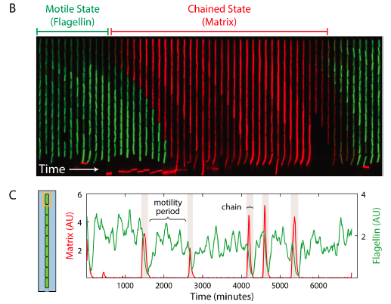
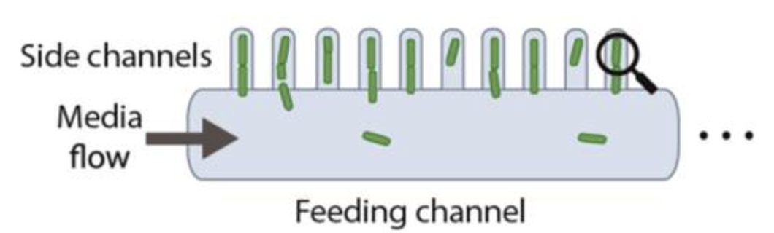

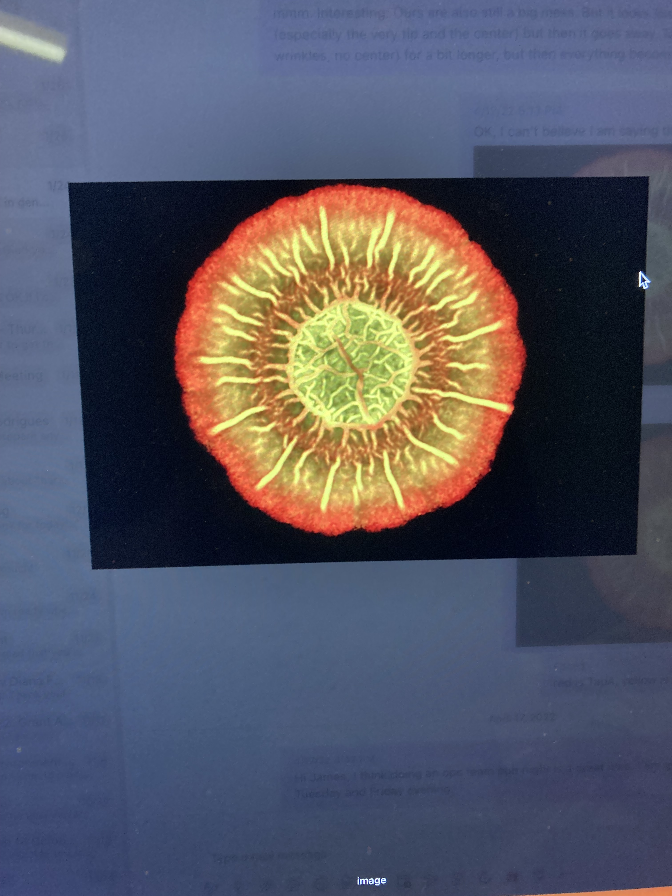

Motivation
Potential motile-matrix phase two-way phenotypic changes
At single cell-level, two-way switching experimentally observed
Nathan D Lord et al (2019) doi:10.1126/science.aaw4506.
At population-level, 2D double/triple rings observed (long enough)
Can it also be a switch? Or other mechanisms?
Green – motility cell (Phag)
Pink – matrix producing cell (PtapA)
Yellow – motility cell (Phag)
Red – matrix producing cell (PtapA)
1d -> 3d -> 5d
~Double switch Triple switch!
https://onlinelibrary.wiley.com/doi/10.1111/dgd.12383
Leaving the colony to grow
Early: The subpopulation at the edge become tapA expressor (matrix)
Over a long time: The second layer of hag expressors (motile) emerge at the edge
H1: the hag expressors previously in the middle escape to the edge
✅ The lab’s work: confirm that the escape can occur (and that it does not need flagella but wrinkle in the biofilm… another story)
H2: growth rate of peripheral motile cell > growth rate of matrix cell
Hard to track cell division at individual level in a biofilm
H3: the tapA expressor at the edge that switch back to hag expressor 🎯
Seen in a mother machine*
but still no confirmed observation in the biofilm
H1: the hag expressors previously in the middle escape to the edge
The lab’s work confirms that the escape can occur and that it does not need flagella but wrinkle in the biofilm… another story
H2: There are actually the mixed population of motile cells and matrix cells at the edge when the first ring emerges, but the growth rate of peripheral motile cell > that of the matrix cell. Therefore, the second ring is filled with faster-growing motile cells.
Hard to track cell division at individual level in a biofilm
H3: the tapA expressor at the edge that switch back to hag expressor 🎯
Seen in a mother machine*
but still no confirmed observation in the biofilm

Slide 5
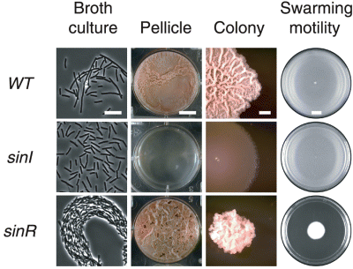
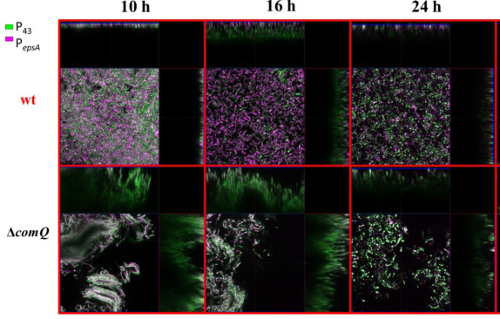
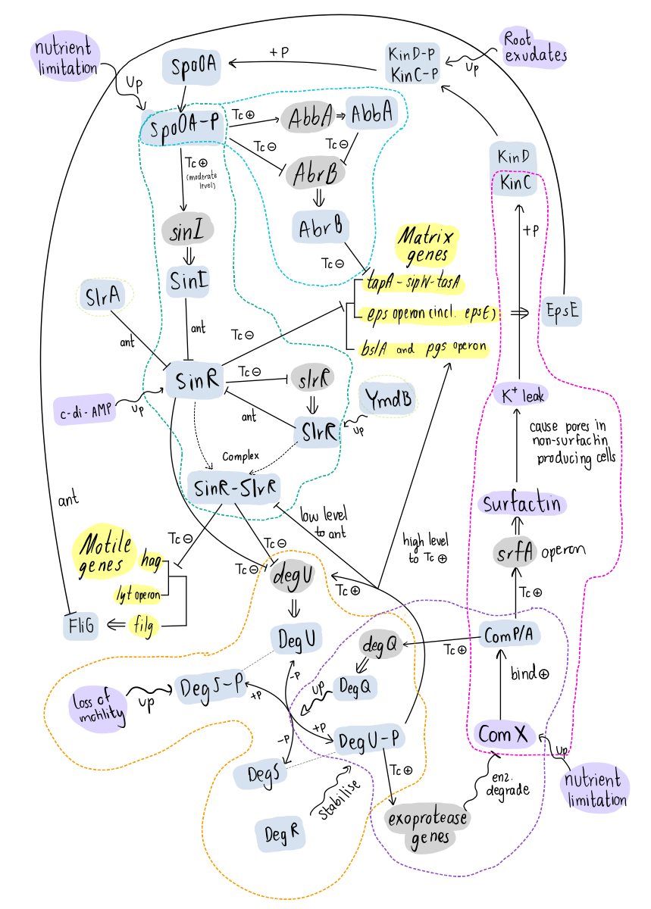
Aim
Current aim: How is the switching regulated at a single-cell and biofilm level (considering noise and nutrient level)
Identify and manipulate the key genes to lock them in one phase
Compare the fitness of differently manipulated colonies over time
Understand the switch regulation
(Final aim: Why do bacteria have this switching? Fitness of whole population increases? How?)
Limitation with only using molecular techniques
Potential Network
High complexity – Due to many types of interactions, feedbacks of gene products to the network, input signal from environment e.g. nutrient
Increasing evidence of the important role of noise (may be the reason for low reproducibility)

Slide 6
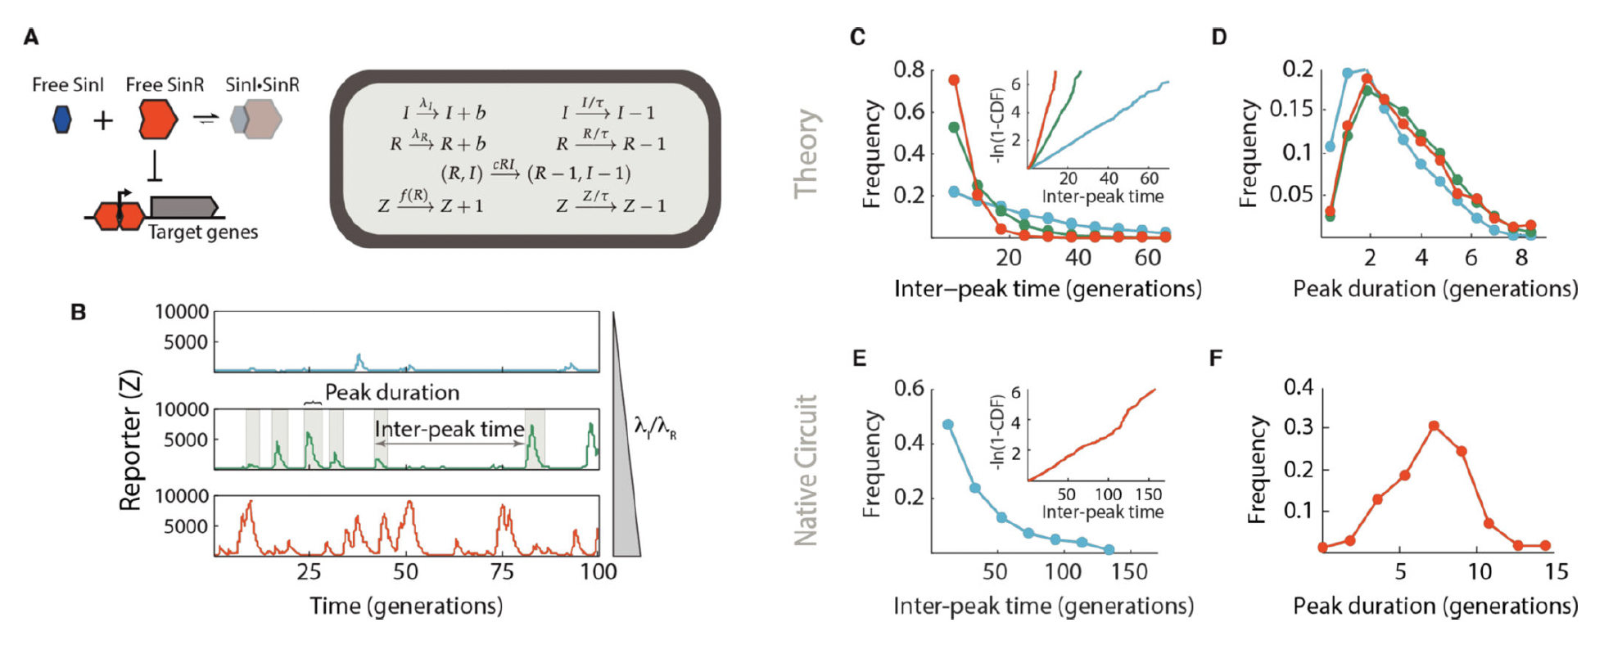
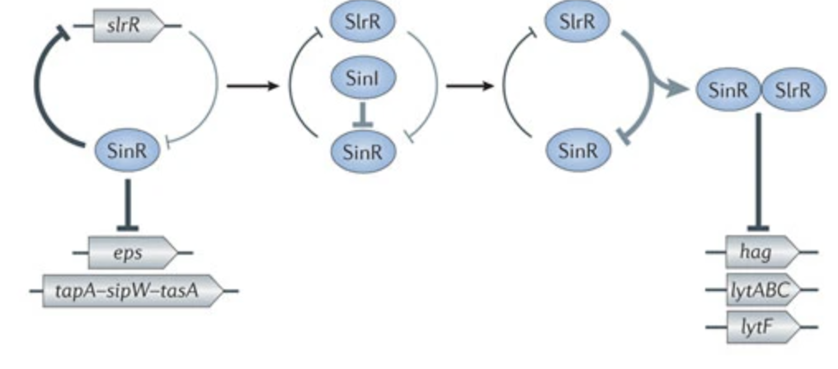
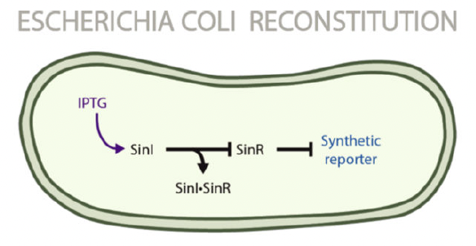
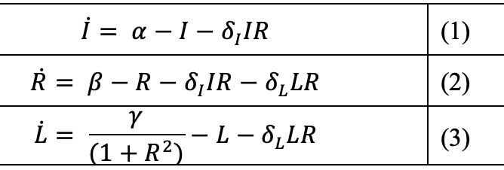
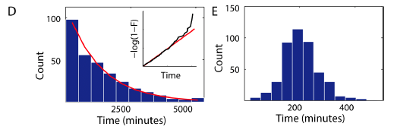
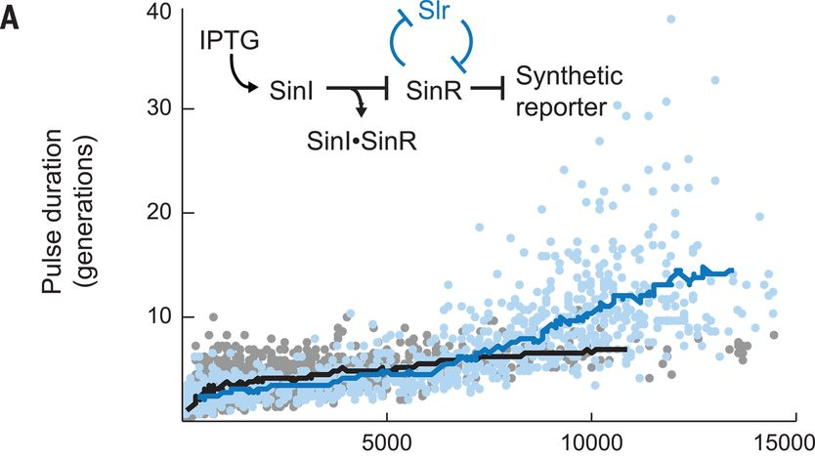
Modelling #1 – single cell
Nathan D Lord et al (2019)
General concept:
But something disturbs bistability even in a single cell
High free SinR
= Matrix off
Low free SinR
= Matrix on
Inter-peak period = High R
A very reduced, simple model between SinI, SinR, SlrR can replicate experimental data of B. subtilis in a mother machine
when noise added in simulation
-> math representation
3 Variables: SinI (I), SinR (R), SlrR (L)
5 Parameters: allow monostability or bistability outcome
=>
One initial condition --- > one stable fixed point
expo dist
-> memoryless
narrow dist
-> timing
≈ Inter Z peak duration
= when high R
= when motility expressed
= no timing: cell don’t know how long they are in motile phase
≈ Z Peak duration
= when low R
= when matrix expressed
= waiting time to motility; cells know how long they are in matrix phase
To test this hypothesis, we added the slrR gene to the reconstituted E. coli circuit under the control of a second synthetic SinR-repressible promoter (Materials and Methods, ‘Plasmid and strain construction’). Reporter pulses could indeed be made much longer in the presence of SlrR (Fig. 3A,B, Movie S3) while leaving the memoryless initiation process quantitatively intact (Fig. S15). The slrR system thus allows the cell to generate large pulses of gene expression even in a parameter regime that creates only small, rare bouts of SinI dominance.

Slide 7
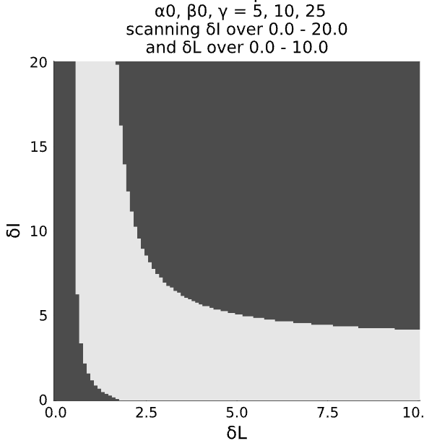
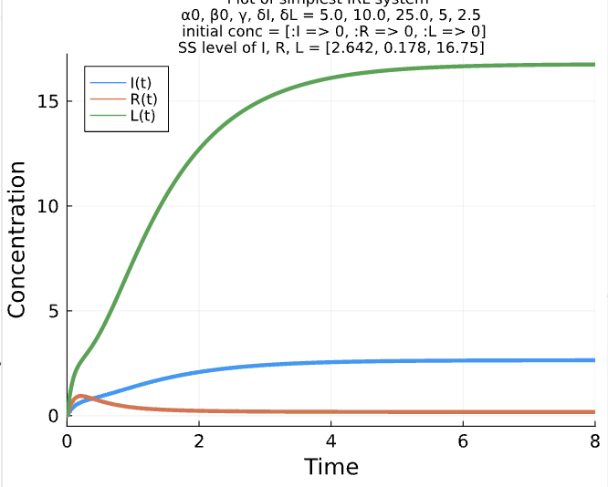
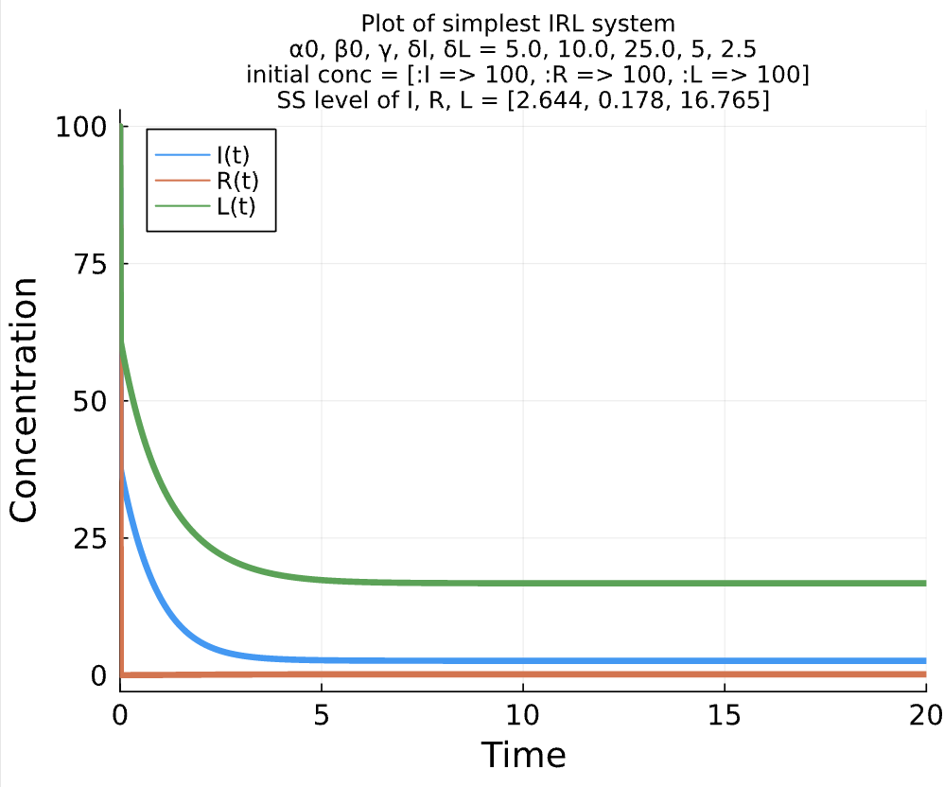
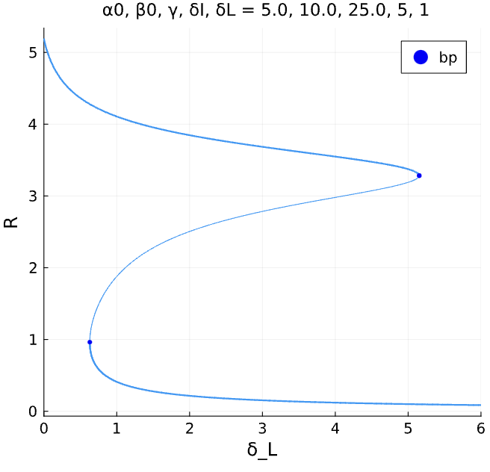
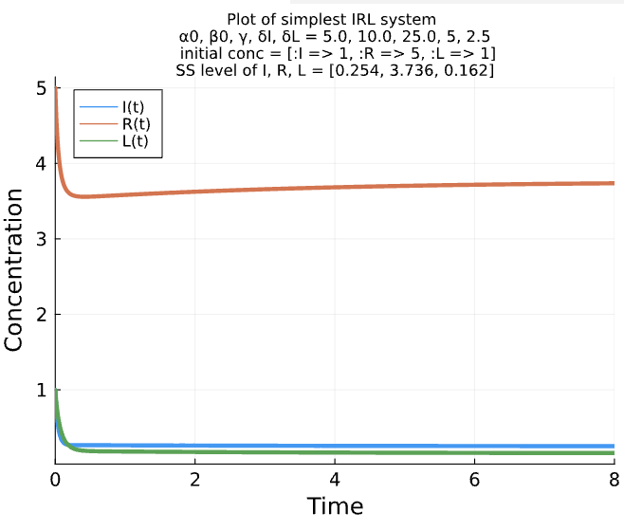
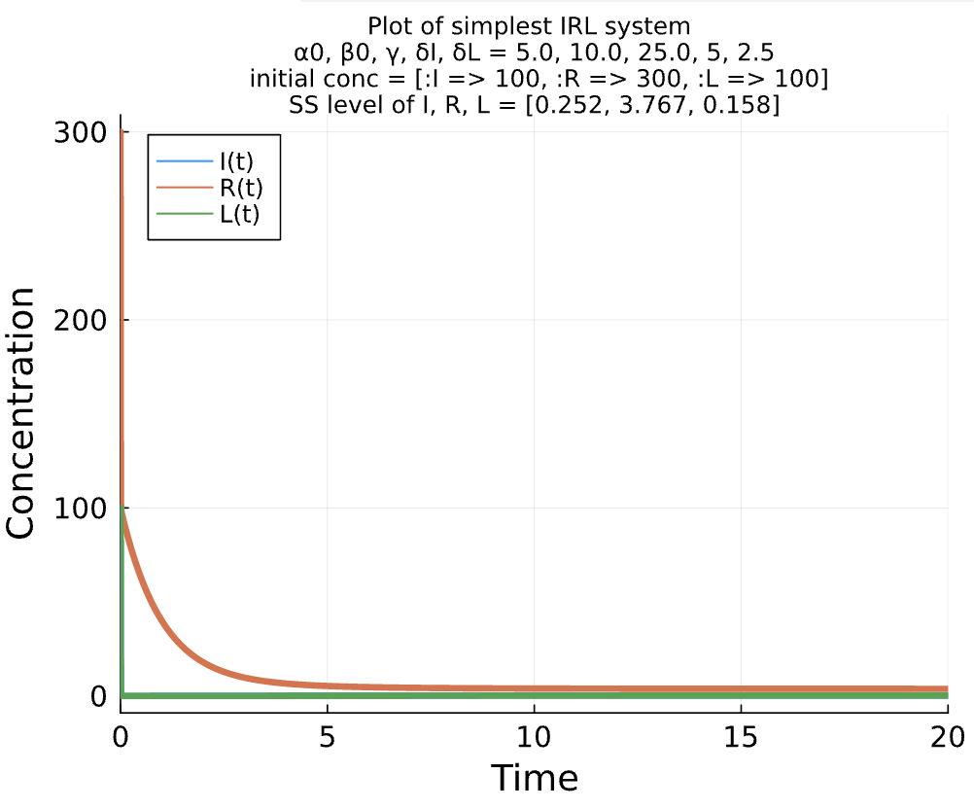
Finding #1.1 – single cell – deterministic
In a bistability region, depending on Initial conditions,
the outcome will be in either
Low R = High L = matrix phase
High R = Low L = motile phase
Parameter space:
Fix protein production rates - 𝝰0 𝝱0 𝝲
Scan only complexing rates
- 𝛅I 𝛅L
When δI = 5.0, δL = 2.5
 | I0 | R0 | L0 | Rss
1) | 0 | ≤3 | 0 | 0.178
 | 100 | ≤200 | 100
2) | 1 | ≥4 | 1 | 3.736
 | 100 | ≥300 | 100
Monostability
Low R =
Matrix on
High R =
Matrix off
(0,0,0)
(100,100,100)
Bistability
Bifurcation diagram
When δI = 5
(1,5,1)
(100,300,100)

Slide 8
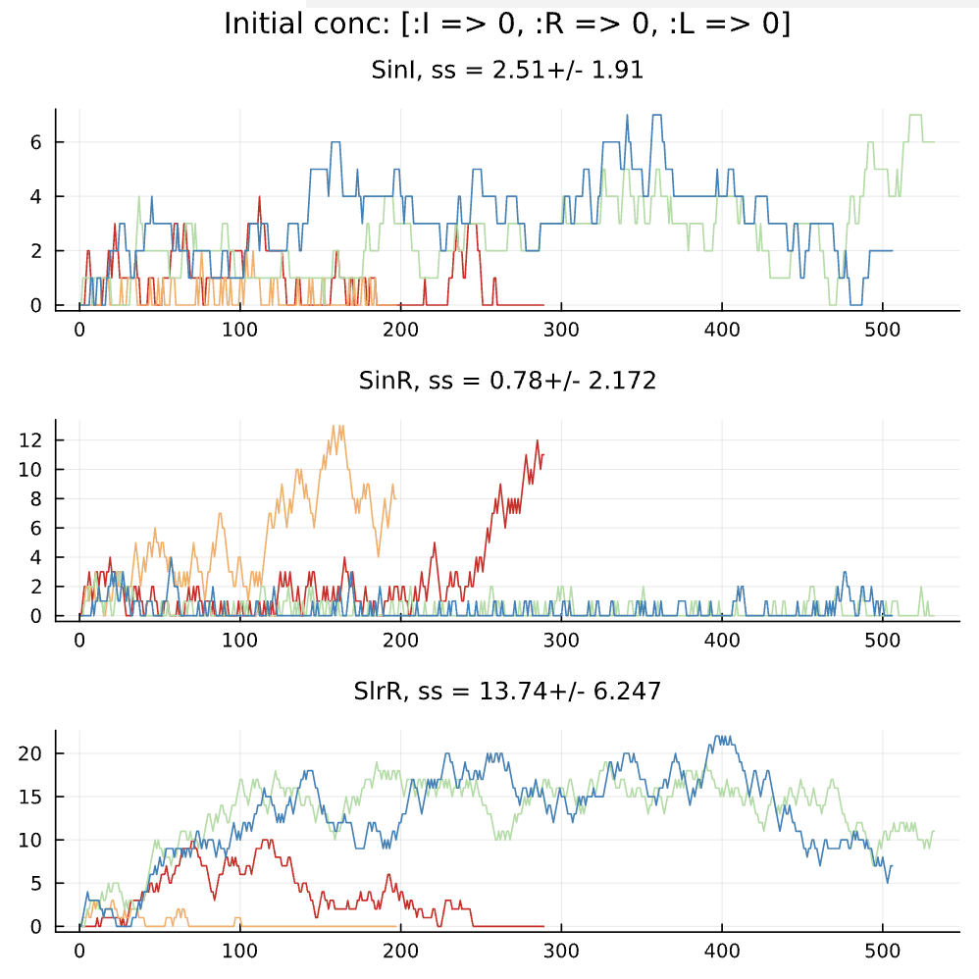
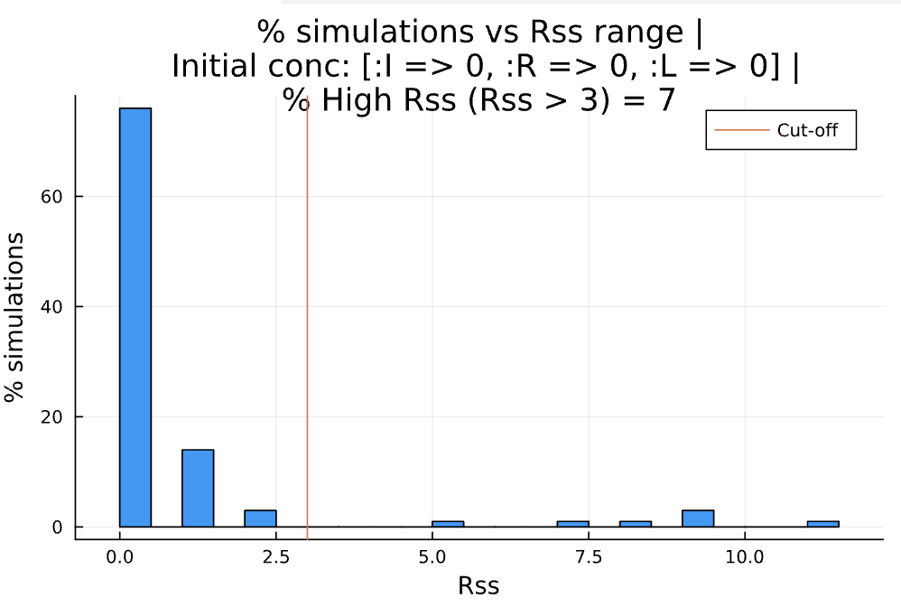
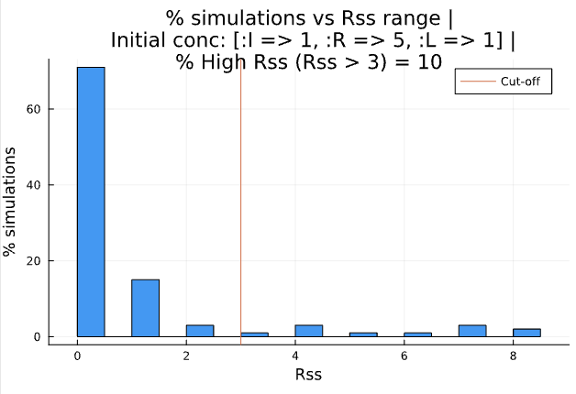
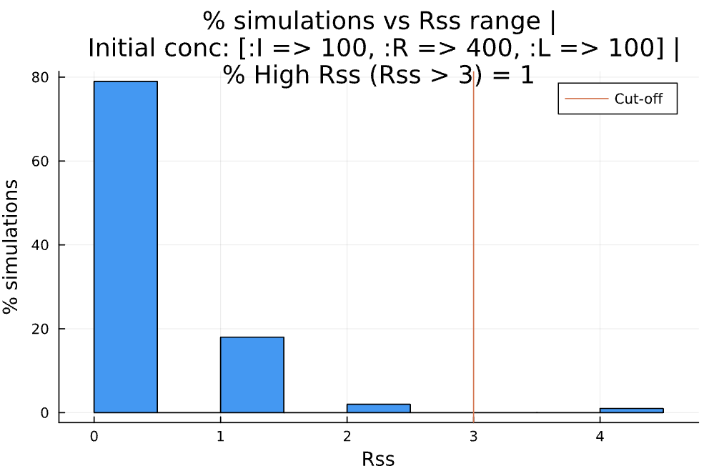
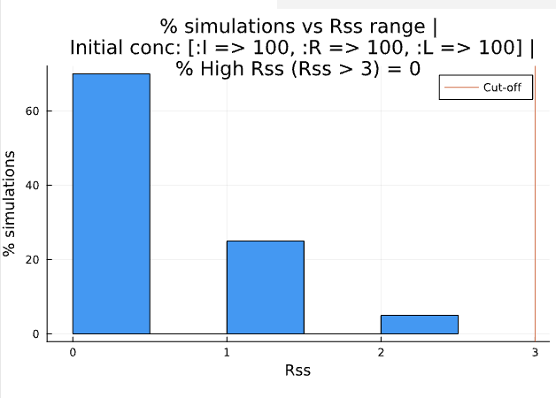
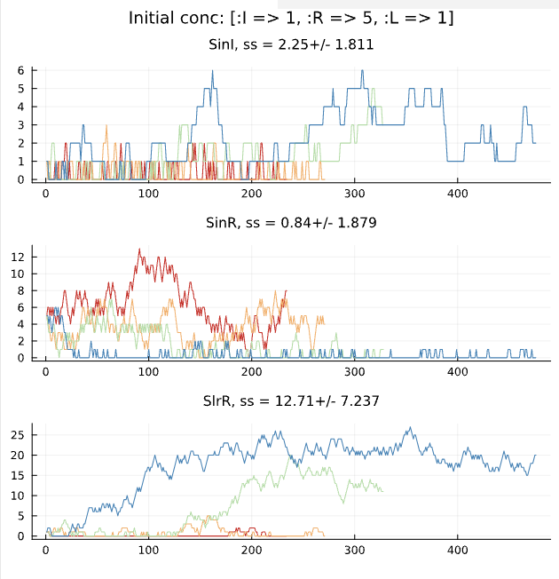
Finding #1.2 – single cell – stochastic| Low Rss <-> High Rss
A deterministic low Rss case:
Noise makes a few number of runs to reach a high Rss
A deterministic high Rss case:
★Noise greatly favors a low Rss (matrix on)
High Rss
Low Rss
Depends on init cond.
 | I0 | R0 | L0 | Rss
1) | 0 | ≤3 | 0 | 0.178
 | 100 | ≤200 | 100
2) | 1 | ≥4 | 1 | 3.736
 | 100 | ≥300 | 100
Conclusion: Noise can indeed change qualitative feature
But why a low Rss (matrix on) seems to be favored in all cases?
Is it because of relatively high I and L production rates? – could be – will check

Slide 9
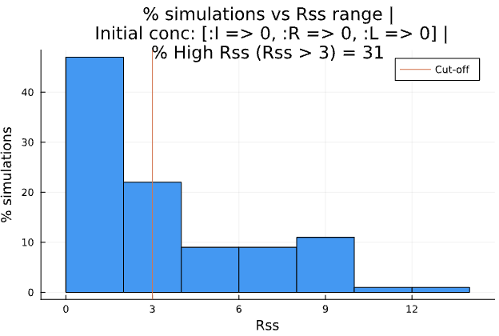
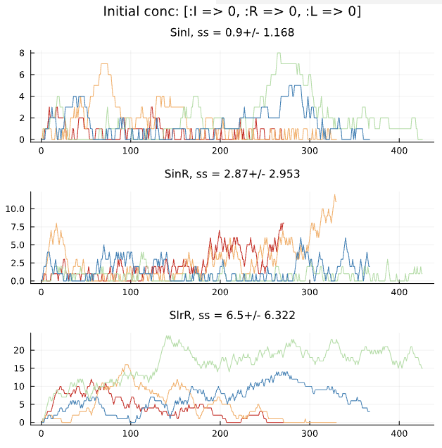
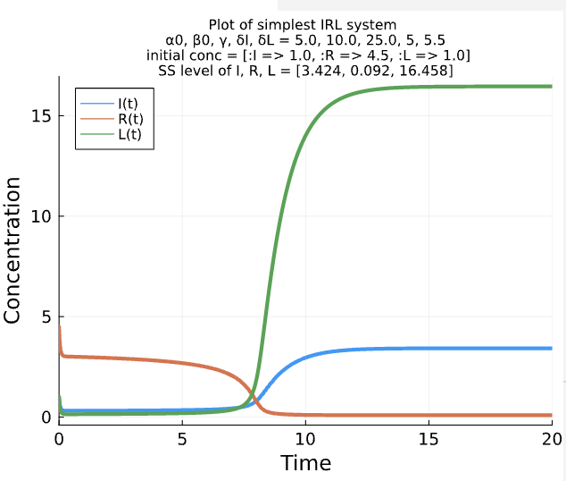
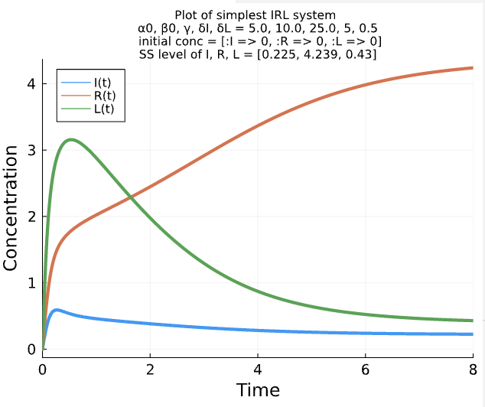
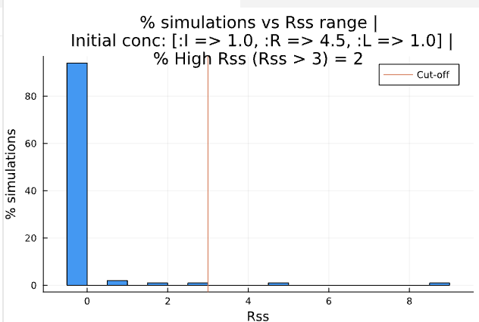
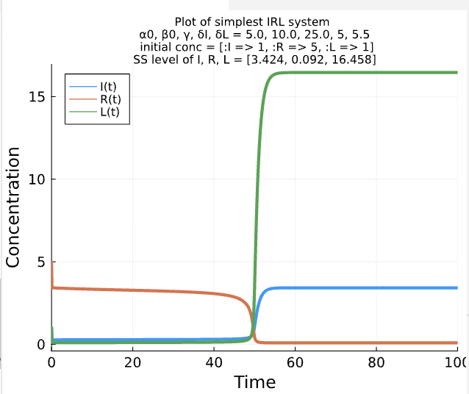
Finding #1 – single cell
different parameters: HighRpars and LowRpars
 | I0 | R0 | L0 | Rss (vs old pars)
1) | 0 | 0 | 0 | 4.239 vs 0.178
2) | 1 | 4.5 | 1 | 0.092 vs 3.736
Same conclusion: Noise favors a low Rss (matrix on) even when deterministic run predicts a high Rss
Less conclusive: when a low Rss is predicted from deterministic run,
A very few cases deviate

Slide 10
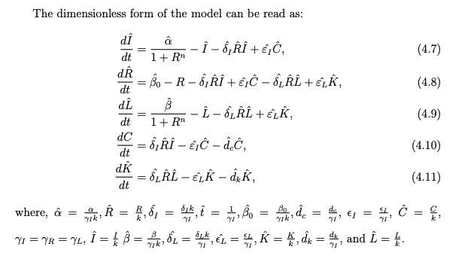
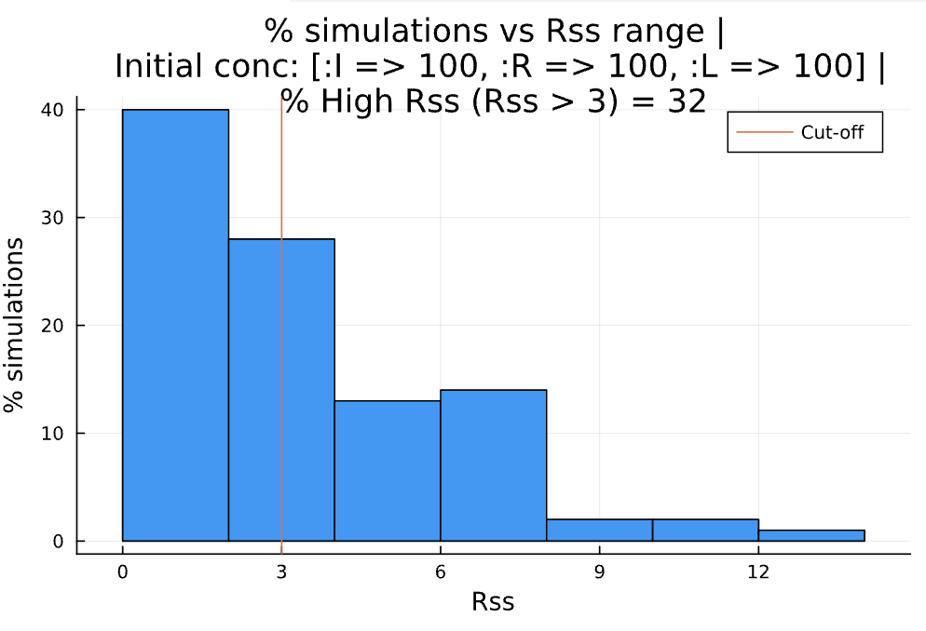
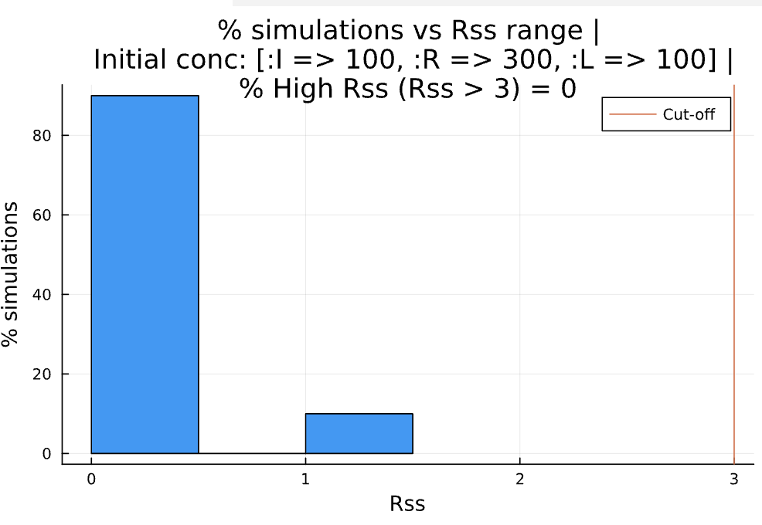
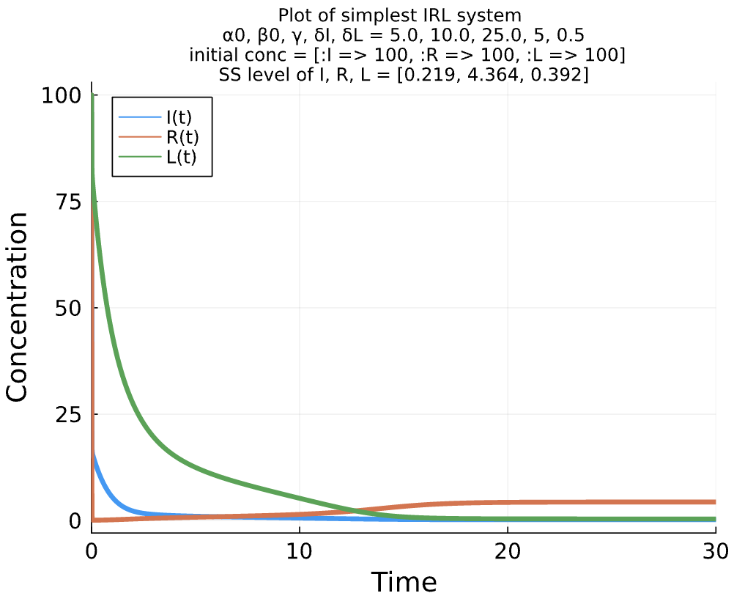
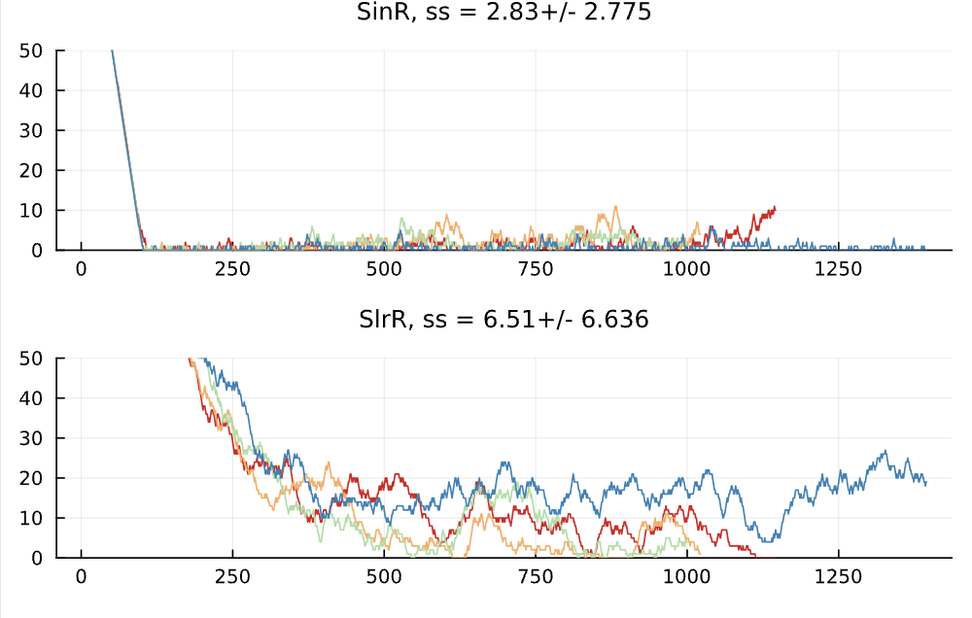
Finding #1.3 – single cell – stochastic| mono<->bistable
HighR pars and LowR pars
A) When δL = 0.5 (predict a global high Rss)
B) When δL = 5.5 (predict a global low Rss)
★Noise still favors a low Rss (matrix on)
No high Rss case is found even when R0 is high
A)
B)
Quite fluctuated – find a better quantification index for noise effect?

Slide 11
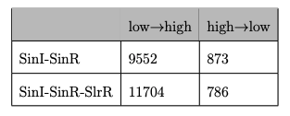
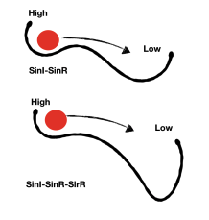
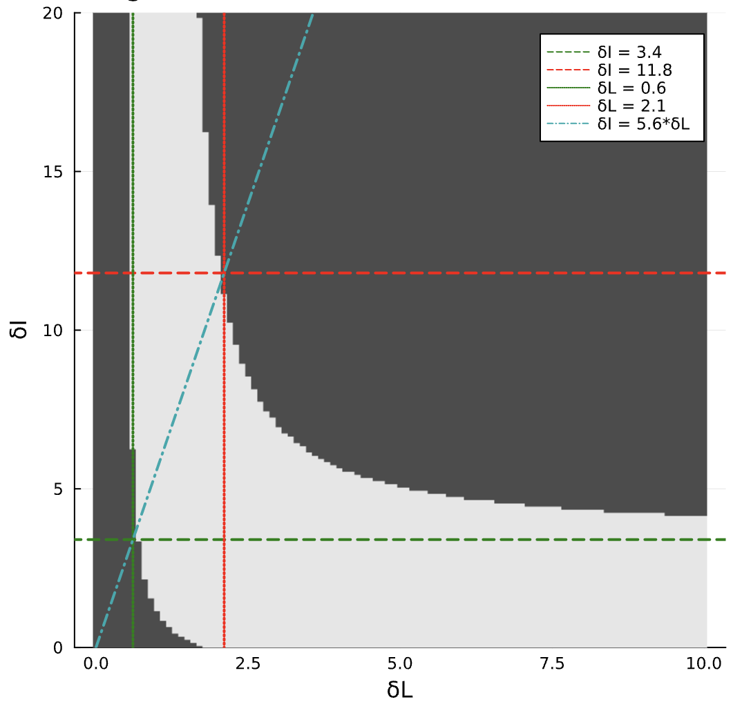
Summary:
Noise can indeed change qualitative features at single cell level
The system with noise favors matrix ON (low Rss) even when the number of protein molecules is high and when it is predicted to have a global or local high Rss
Similar to a finding from one thesis paper
Could this be the additional mechanism to form the first ring of matrix cells (Low Rss)
Time till switch
1d -> 3d -> 5d
Alharbi, Yamen (2022)
Find values of parameters – that represent the physiology range better
The noise susceptibility increases close to bifurcation point
δI (3.4-11.8) should be 5.6 fold higher than δL (0.6-2.1)

